Slide 1
Django Authentication

Slide 2
Introduction
Django comes with a user authentication system. It handles user accounts, groups, permissions and cookie-based user sessions. This section of the documentation explains how the default implementation works out of the box, as well as how to extend and customize it to suit your project’s needs.

Slide 3
Overview
The auth system consists of:
Users
Permissions: Binary (yes/no) flags designating whether a user may perform a certain task.
Groups: A generic way of applying labels and permissions to more than one user.
A configurable password hashing system
Forms and view tools for logging in users, or restricting content
A pluggable backend system
The authentication system in Django aims to be very generic and doesn’t provide some features commonly found in web authentication systems. Solutions for some of these common problems have been implemented in third-party packages:
Password strength checking
Throttling of login attempts
Authentication against third-parties (OAuth, for example)
Object-level permissions

Slide 4
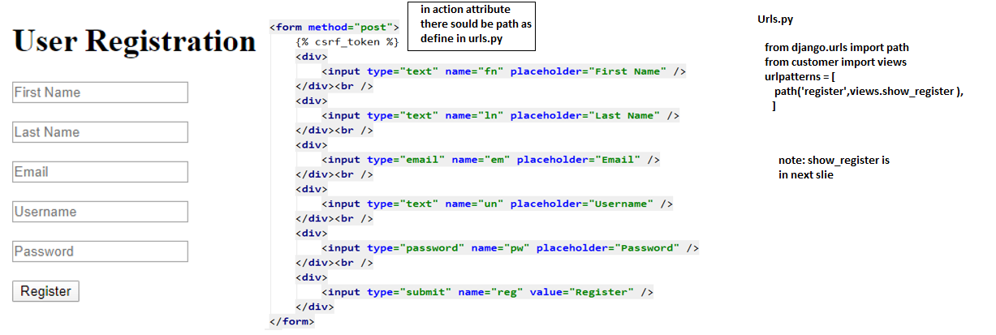
User Registration Form

Slide 5
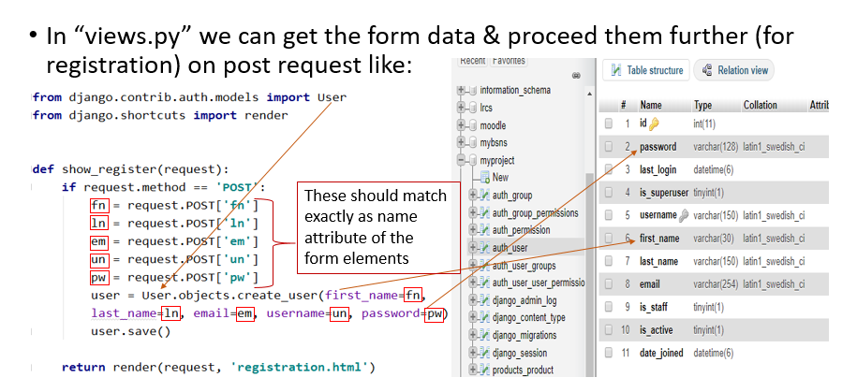
Creating User

Slide 6
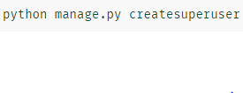
Creating User by command line

Slide 7
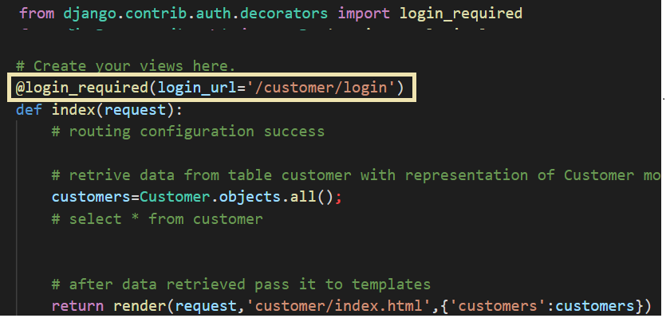
Adding Decorator

Slide 8
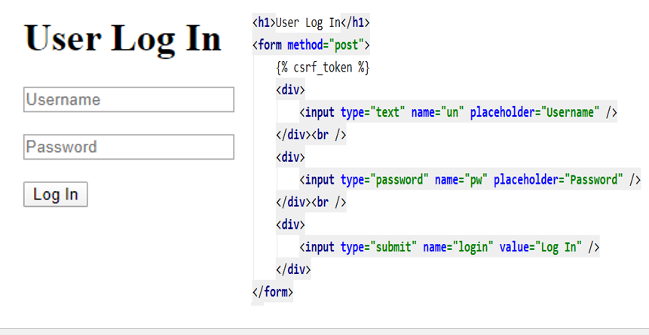
Login Form

Slide 9
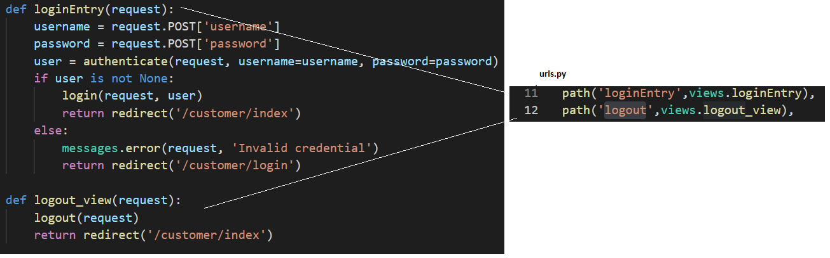
Login and logout function

